Slide 1
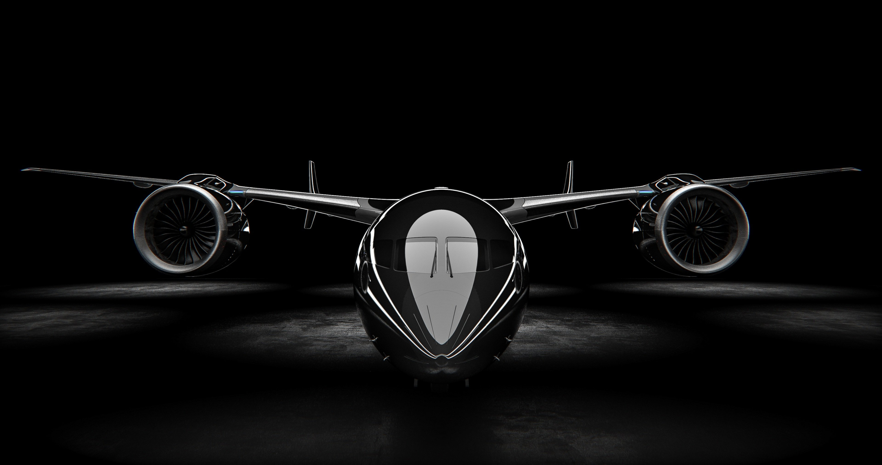
SKY RELIC
FLIGHT SIMULATION PROTOCOL
Presented by: Sandesh, Anamol, Biplov and Sudhir

Slide 2
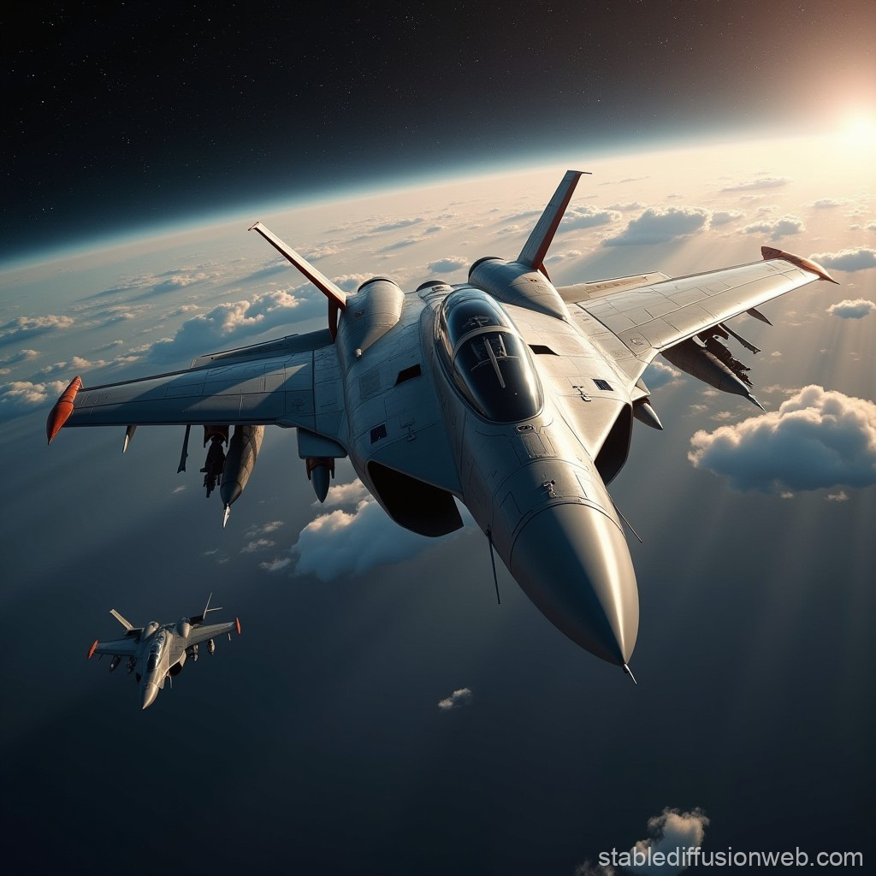
PROJECT VISION
Sky Relic aims to blend real-world weather with simple flight gameplay, creating a fun and strategic exploration experience for all players.
Create a simple, fun flight-exploration game
Use real weather + airport data
Offer strategic choices and light adventure

Slide 3


GOALS OF THE PROJECT
BUILD A FULLY PLAYABLE WEB-BASED FLIGHT GAME
USE REAL-TIME WEATHER + AIRPORT DATABASE
DESIGN A PREMIUM SCI-FI UI
ADD DIFFICULTY MODES + SCORING SYSTEM
IMPLEMENT A MISSION PROGRESSION SYSTEM
FUTURE GOAL: 3D JET MODEL

Slide 4
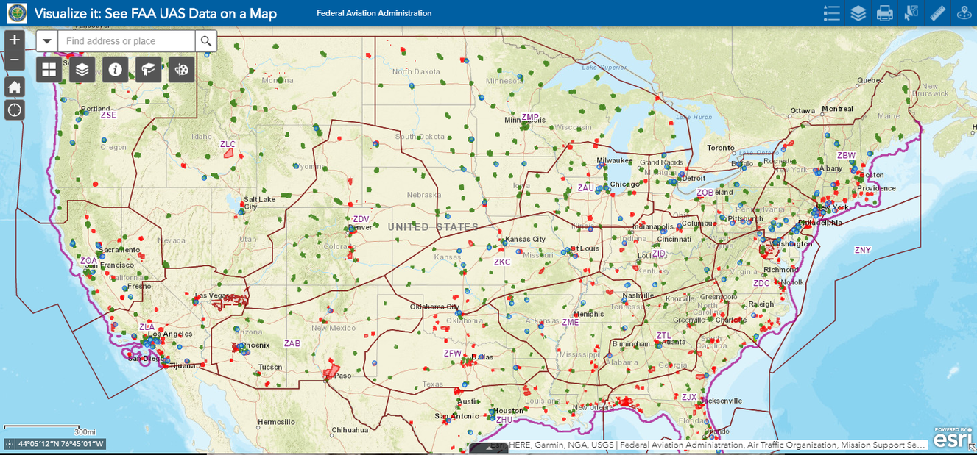


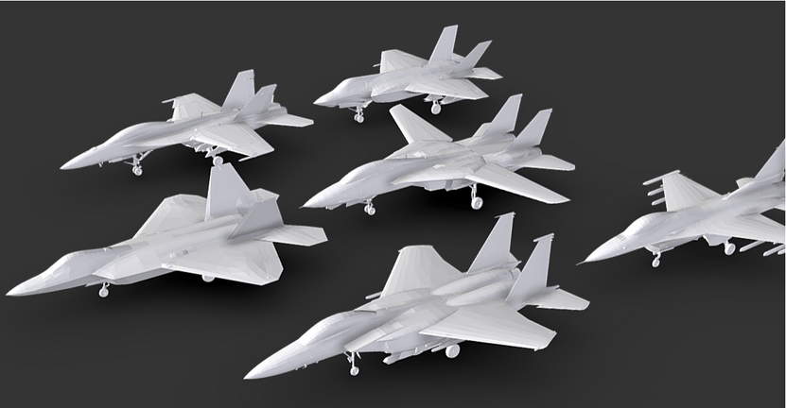
GAME FEATURES
USA AIRSPACE MAP
ENERGY SYSTEM
PAUSE MENU
REAL AIRPORT DATA
POINTS & MISSION SCORING
SUCCESS SCREEN
REAL OPENWEATHER API
DIFFICULTY LEVELS
3D JET MODEL (BETA)

Slide 5
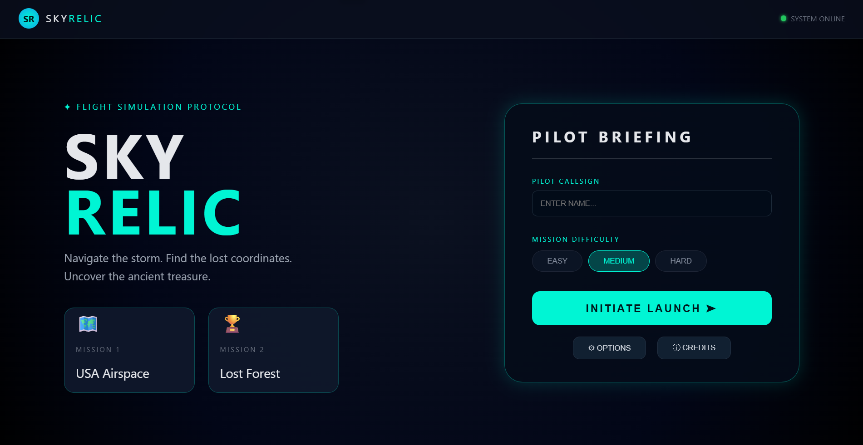
DEMO: HOME SCREEN
Pilot callsign input
Difficulty selection
Mission cards
Initiate Launch button
Premium UI design

Slide 6

TECHNICAL FEATURES
Real-time weather using OpenWeather API
MySQL Airport database
Backend built with Flask (Python)
Frontend using HTML, CSS, JavaScript
Maps rendered with Leaflet.js
3D jet rendered with Three.js

Slide 7
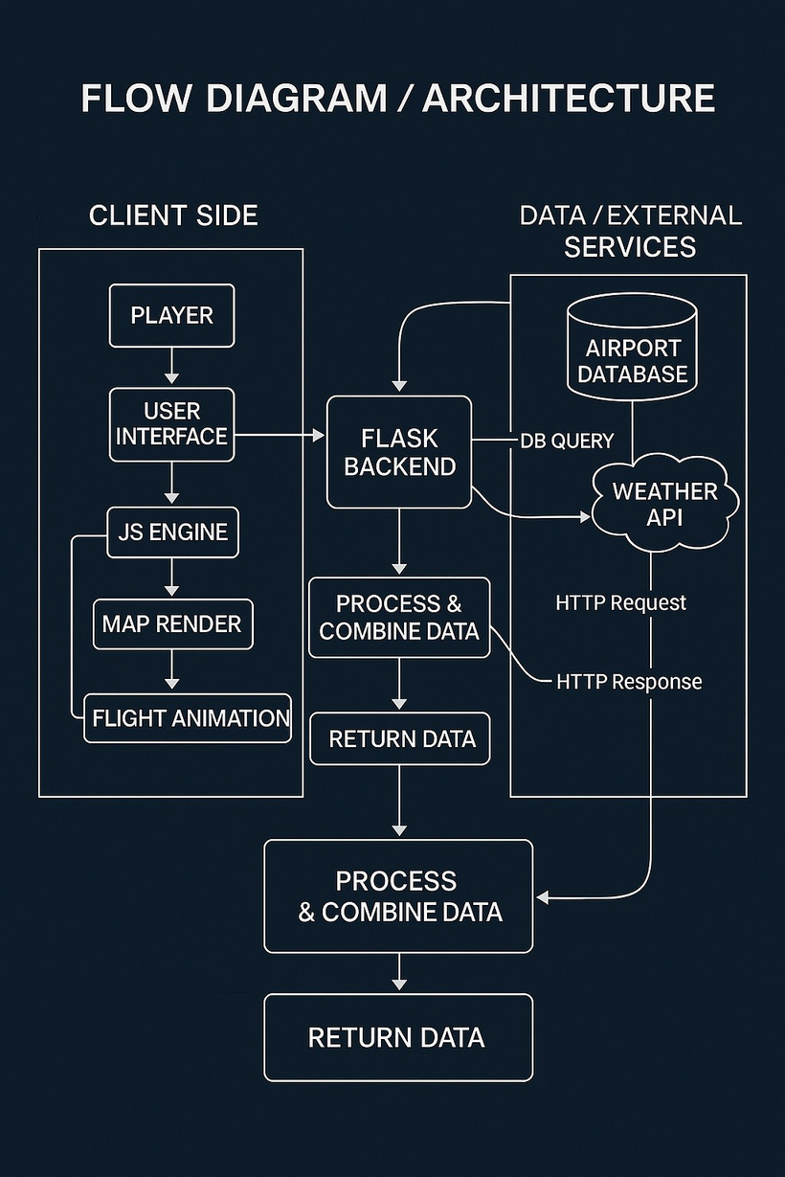
FLOW DIAGRAM / ARCHITECTURE

Slide 8









TECHNOLOGIES USED
HTML 5
CSS 3
JavaScript
MySQL
Python
Three.js
Flask
OpenWeather API
Leaflet.js

Slide 9
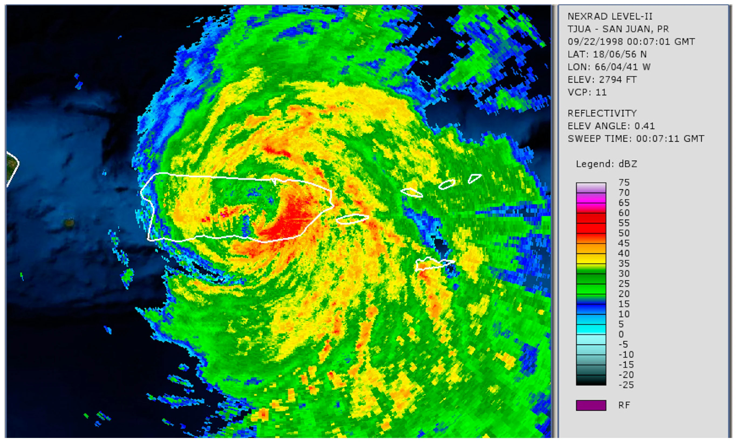
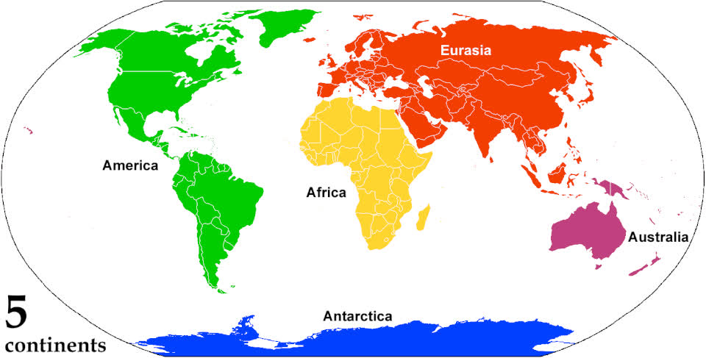

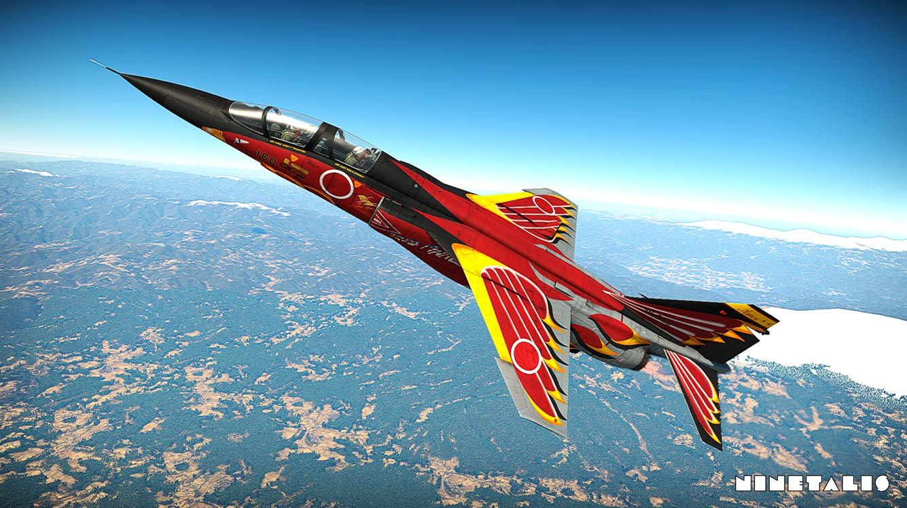
FEATURES YET TO BE IMPLEMENTED
Full 3D animated jet flight path
Sound effects & alerts
Fuel stations + maintenance
Upgradable jets & skins
Global missions (Europe, Asia, Africa)
Multiplayer leaderboard
Dynamic storm events
Forest mission complete gameplay
Mobile-friendly controls

Slide 10

LESSONS LEARNED
Integrating backend + frontend systems
Improved JavaScript map rendering skills
Working with APIs (weather & database)
Designing UI/UX for games
Better debugging and version control usage
Managing time across multiple features

Slide 11

THANKYOU
FOR FLYING WITH SKY RELIC
The mission ends here… but the skies stay open.

